Slide 1

HI ANCOUVER!
Vue.js Meetup September '18 | Bernhard Mayr

Slide 2
How TypeScript and vuex help you not to think about your application while you are on holiday…
Vue.js Meetup September '18 | Bernhard Mayr

Slide 3
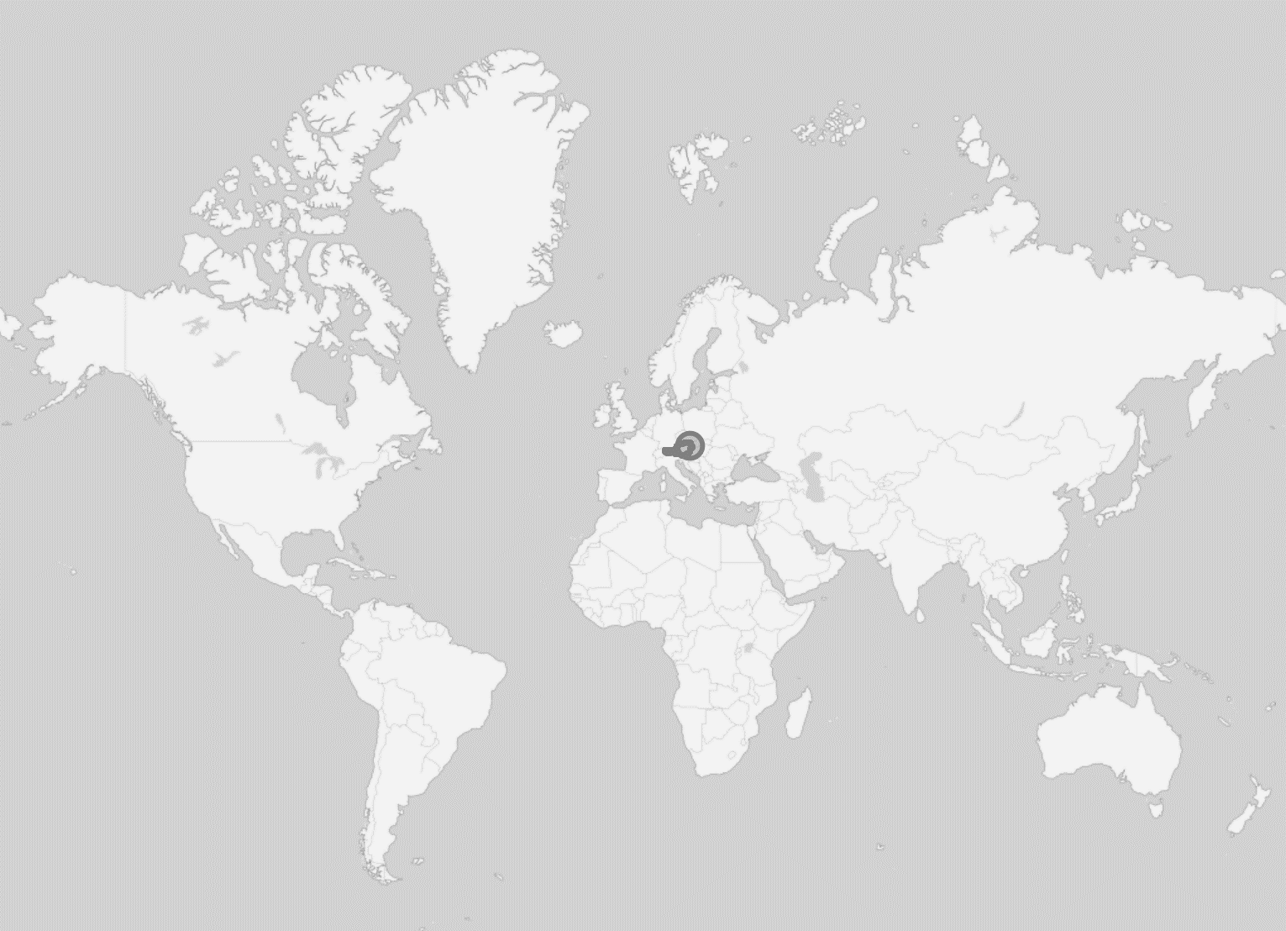



Austria
Bernhard Mayr
/
bemayr
Notes:
[30 sec]

Slide 4








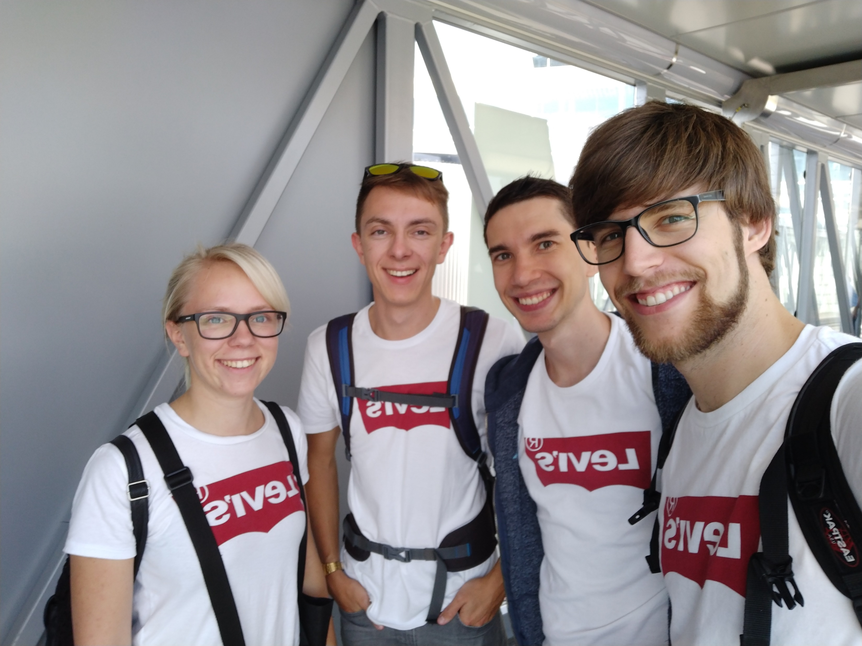

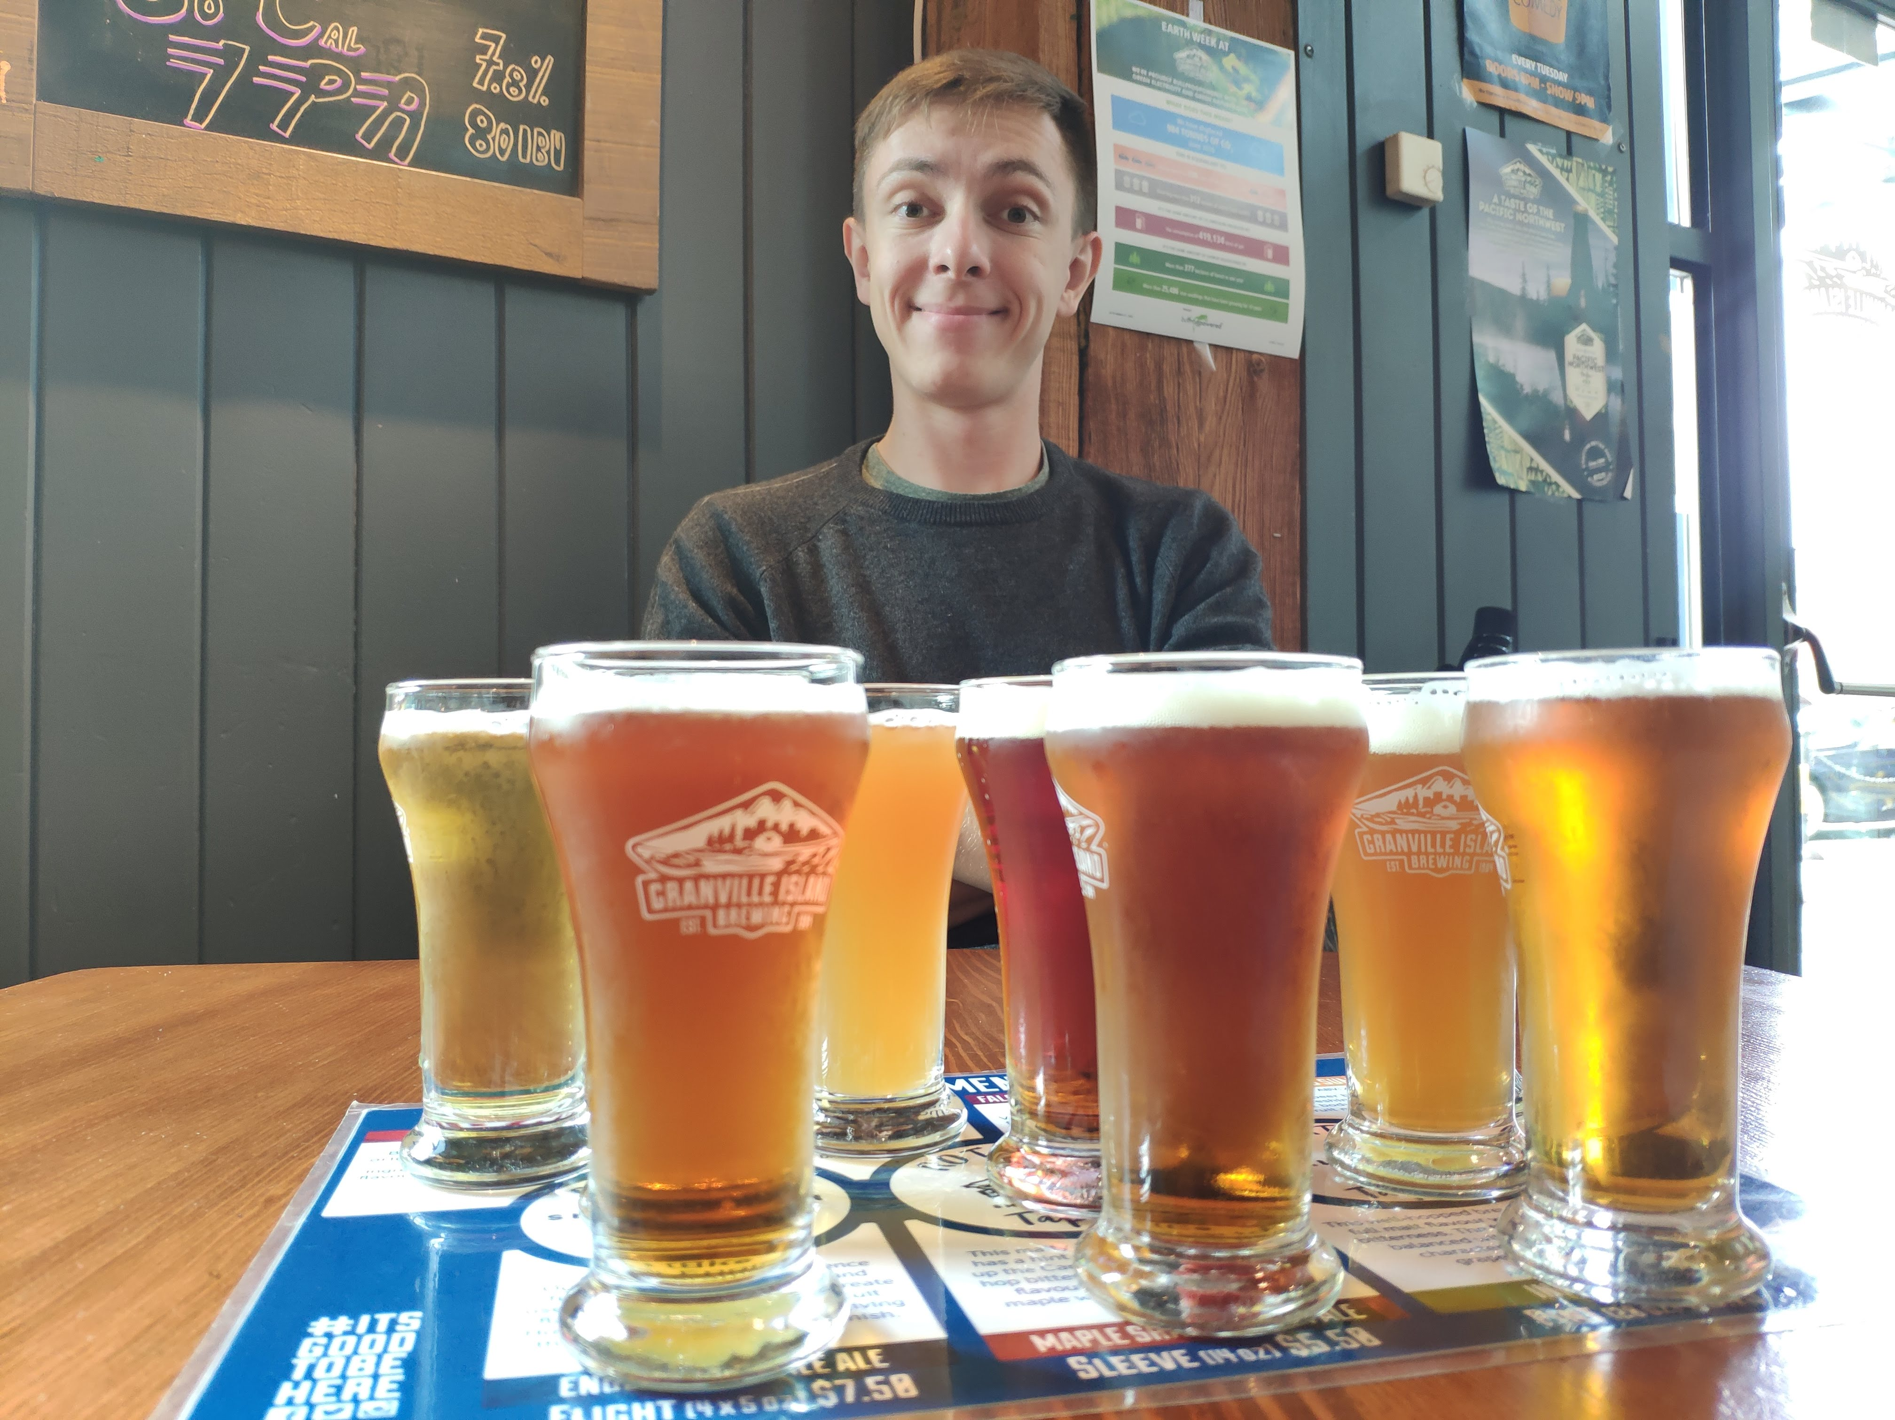

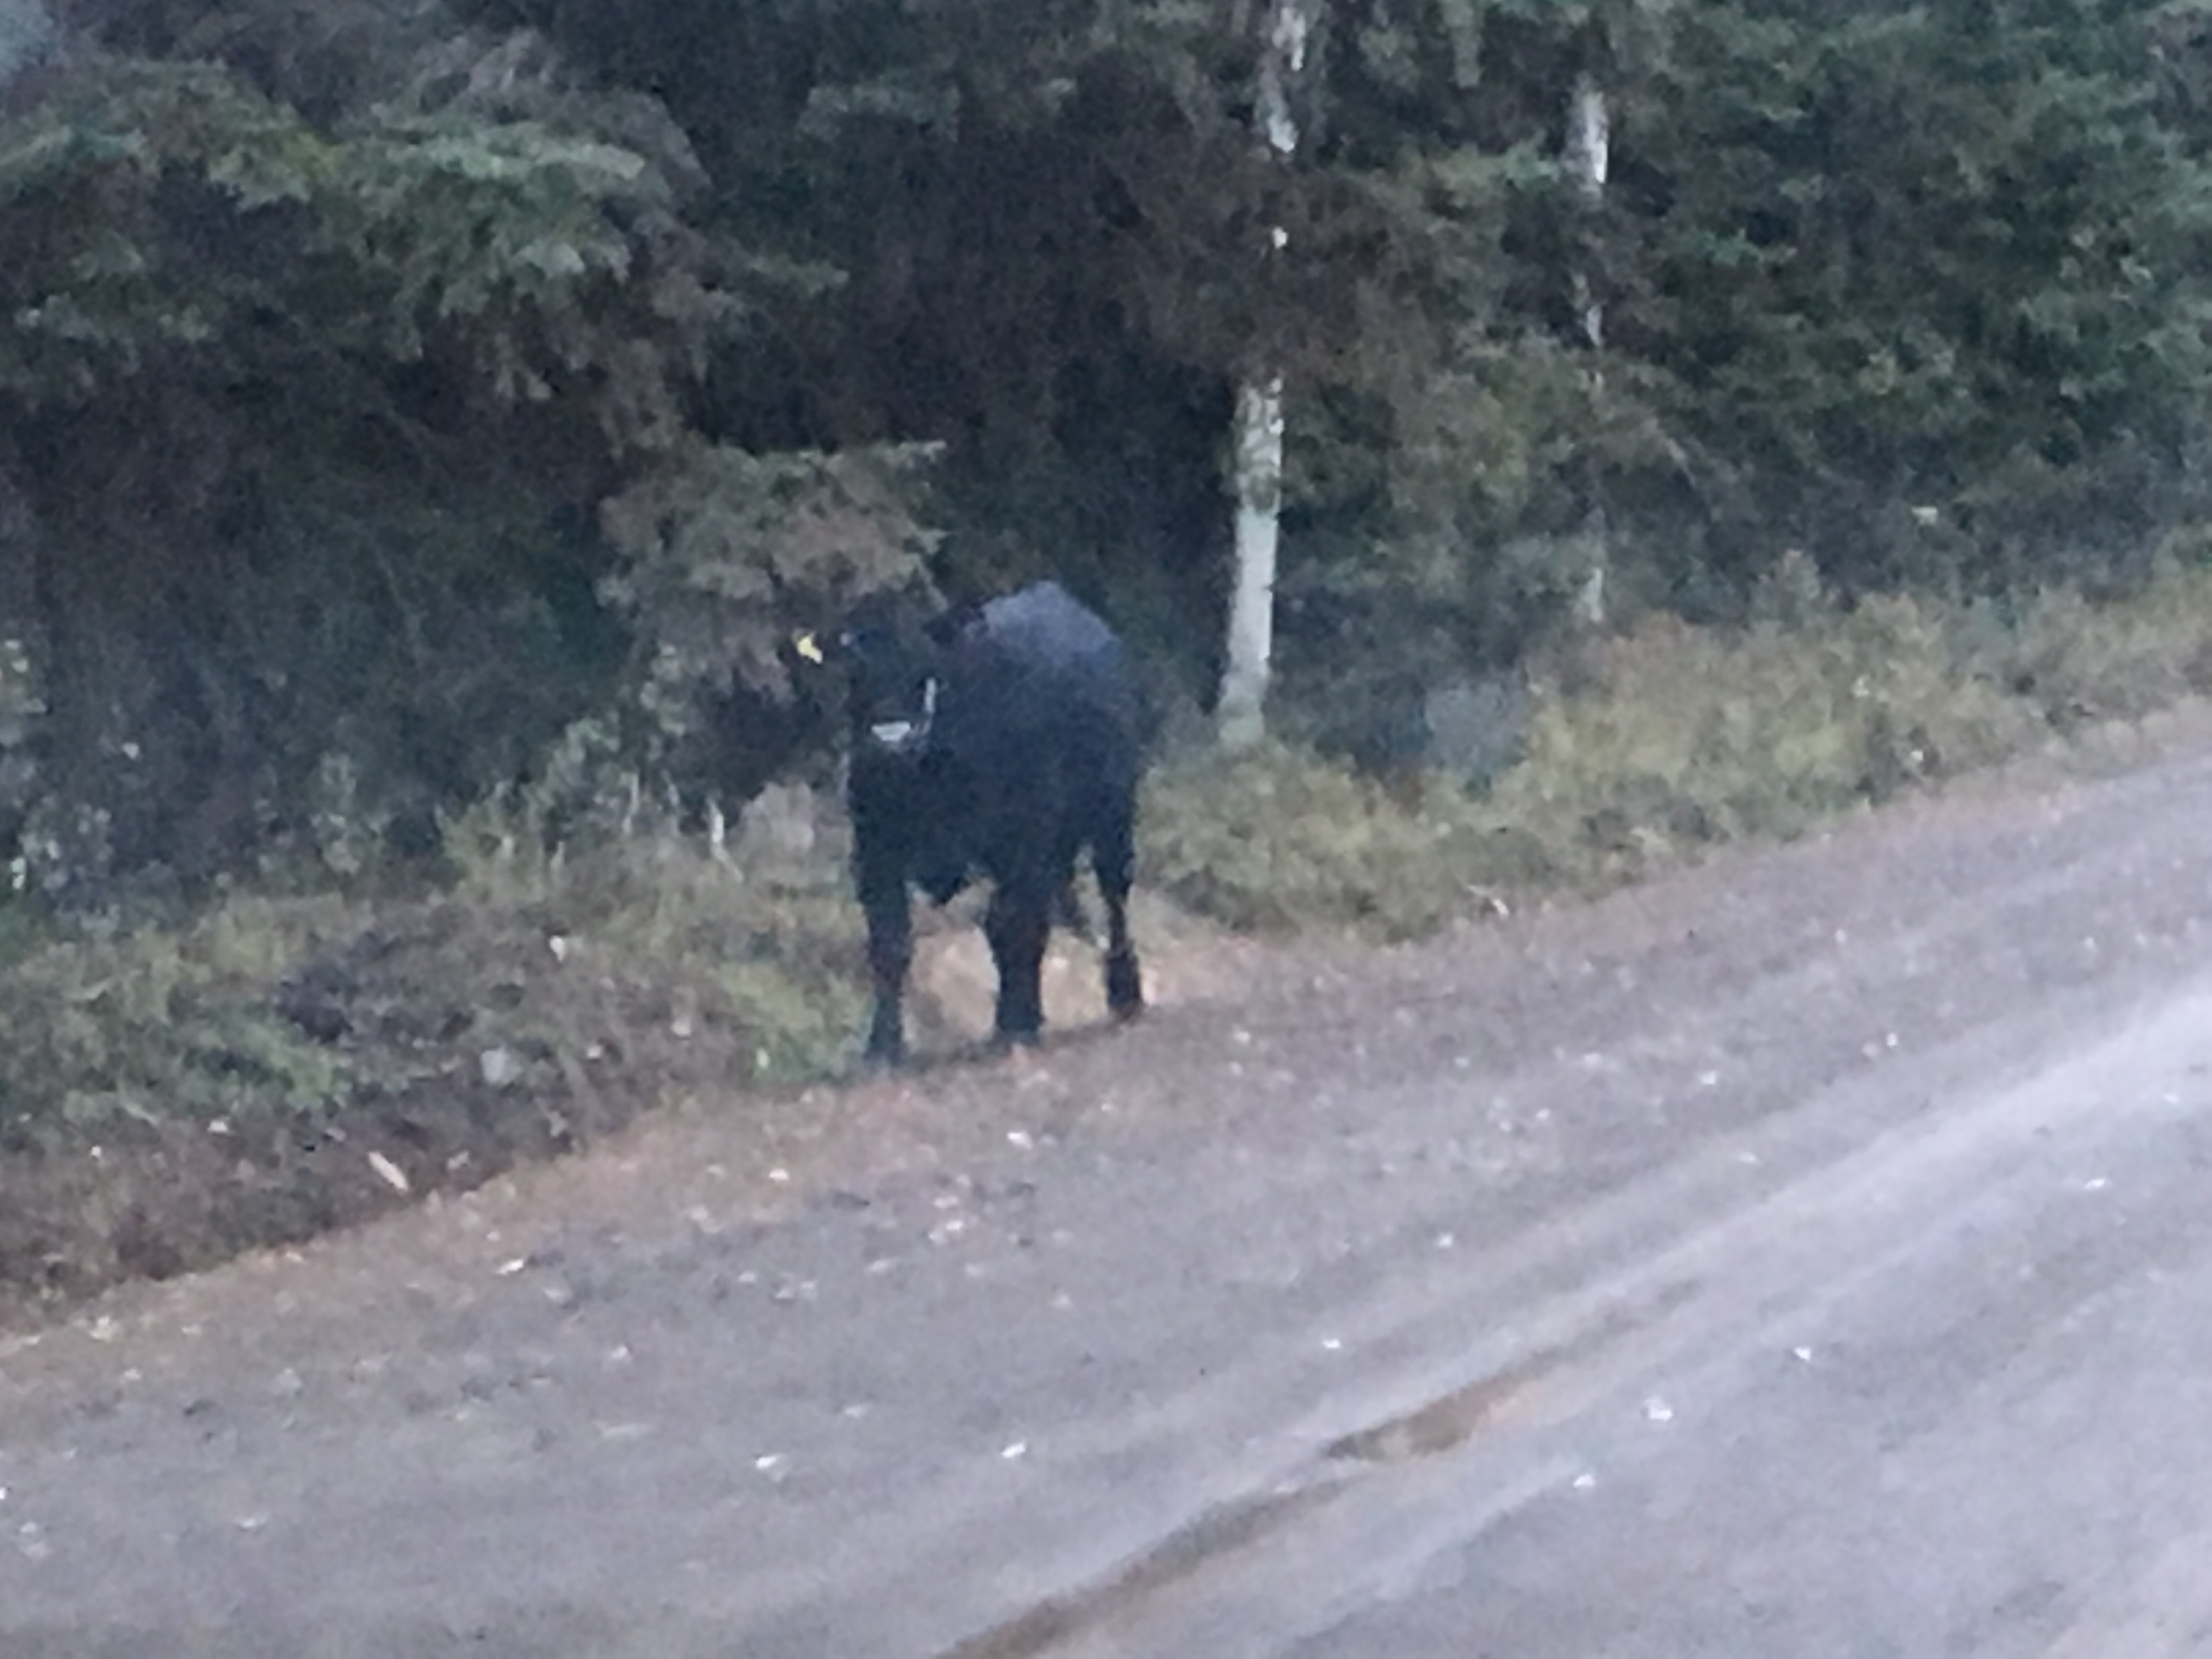




Bernhard Mayr
/
bemayr
Notes:
[30 sec]

Slide 5
studying psychology and philosophy @ university of innsbruck
studied software engineering @ fh hagenberg
working @ Innerspace @ softaware
#types #docker #typescript #ux #types #windows #continousintegration #dotnetcore #types #graphs #electron #vue #vuex #react #errorlesssoftware #dx #types #xplatform #azure #angular #types #haskell #idris #purescript #statecharts #reactivity #typestyle #droneio #types #continuousdeployment
Bernhard Mayr
/
bemayr
Notes:
[30 sec]

Slide 6


VIRTUAL REALITY
BEHAVIORAL TRAINING

Slide 7
?
Who of you has ever used Type-Systems?
Who of you has used vuex?
Who of you has used React/JSX/TSX?
Who of you has any experience with Functional Programming?

Slide 8
TypeScript
https://www.typescriptlang.org/index.html
https://stackblitz.com/edit/vancity-typescript-basics
https://pragprog.com/book/swdddf/domain-modeling-made-functional
https://fsharpforfunandprofit.com/ddd/
Notes:
vue docs typescript

Slide 9
I have to excuse myself with a small sorry for showing you the following 🙈
... but I told myself I have to present this at every java…script-meetup I talk at 🙃
Notes:
[2 min]
- COMIC (alt-tab, make sure photos app is started!)

Slide 10
vuex
https://vuex.vuejs.org/guide/
https://github.com/vuejs/vuex/blob/dev/examples/shopping-cart/
https://medium.com/wdstack/vue-vuex-getting-started-f78c03d9f65
https://coursetro.com/posts/code/144/A-Vuex-Tutorial-by-Example---Learn-Vue-State-Management

Slide 11
{ }
Notes:
vue docs typescript
vuex probleme action/mutation names
konstanten als lösung, aber problem payload
api-design
testing
typescript-Probleme

